Slide 1



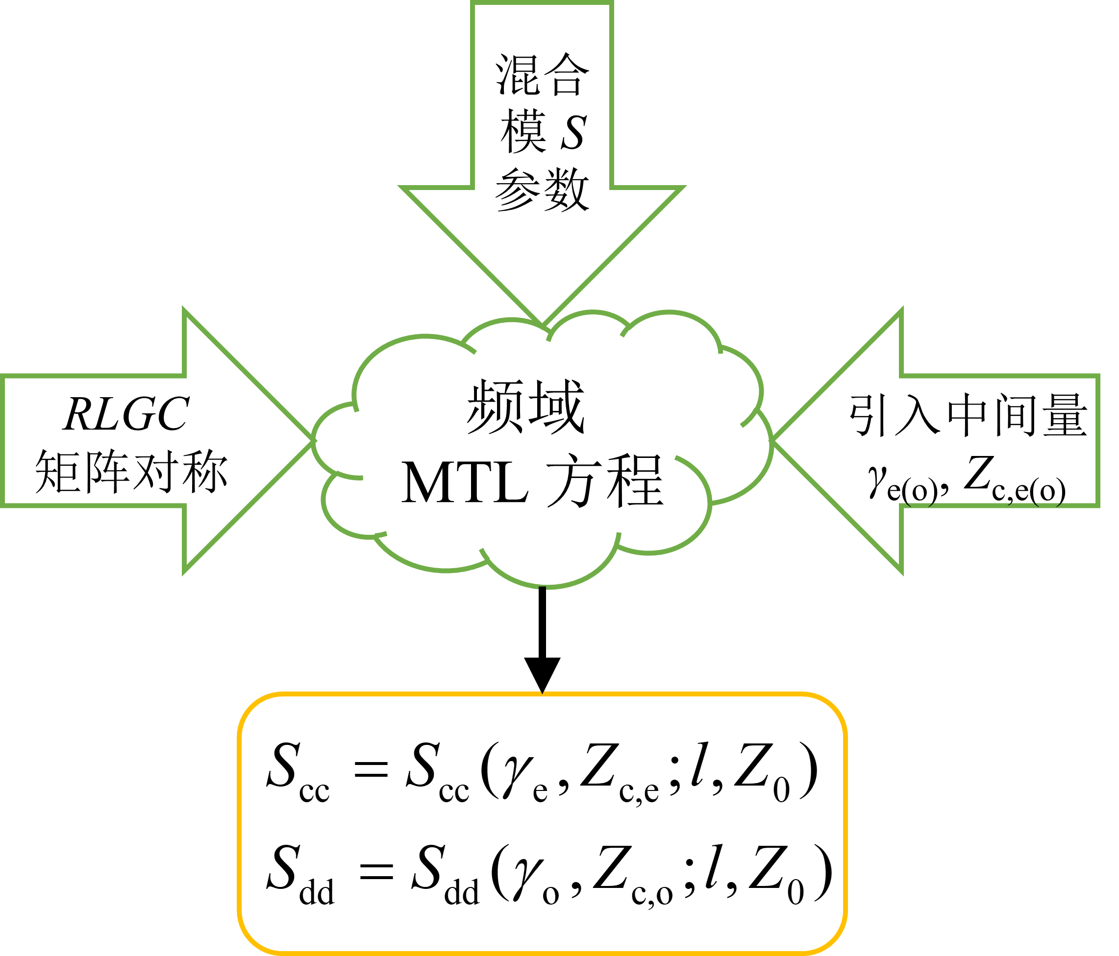
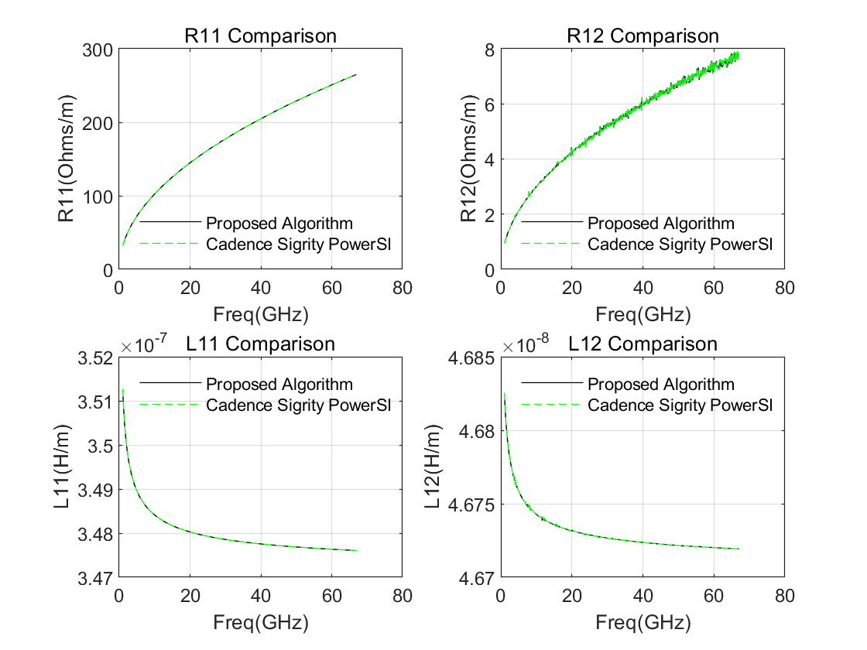

基于 S 参数的耦合传输线 RLGC 参数提取算法
危 国锐¹，夏 彬¹
¹高速电子系统设计与电磁兼容研究教育部重点实验室
（上海交通大学，上海，200240）
一、引 言
二、理论推导
一、引 言
目标
传统的通用方法
通用方法的特点
通用性好
但需要特征值分解、排序
本文工作
推导了平衡差分线的 S 参数关于其 RLGC 参数的表达式
据此简化了差分线的 RLGC 参数提取方案
二、理论推导
定义了差分线的偶/奇模传播常数、特征阻抗 γ_{e(o)}, Z_{c,e(o)}，及它们与 RLGC 参数间的相互转换
导出了差分线的混合模 S 参数关于 γ_{e(o)}, Z_{c,e(o)} 的表达式，以线长 l 和端口参考阻抗 Z₀ 为参变量
最终导出了下图所示的参数变换
RLGC
γ_{e(o)}, Z_{c,e(o)}
S_{cc}, S_{dd}
S 参数
三、算法流程
四、仿真实例
三、算法流程
四、仿真结果
RLGC 提取结果与 PowerSI 对比图
将差分线的单端 S 参数转换为混合模 S 参数
分别由 S_{cc}, S_{dd} ，按[1]的方法提取γ_{e(o)}, Z_{c,e(o)}
由 γ_{e(o)}, Z_{c,e(o)} 的定义式，计算 RLGC
五、结 论
五、结论
本文针对平衡的耦合传输线，导出了一种从 S 参数提取 RLGC 参数的高效算法
算法避免了特征值分解，故更高效易实现
仿真实例表明，本文算法的参数提取效果与主流商用软件的一致性很好
参考文献
参考文献
[1] Eisenstadt W R , Eo Y . S-parameter-based IC interconnect transmission line characterization[J]. IEEE Transactions on Components, Hybrids, and Manufacturing Technology, 1992, 15(4):483-490.
Notes:
各位同行大家好，我是上海交通大学的一个在读硕士生，现在由我向大家介绍我们近期完成的一项工作——基于S参数的耦合传输线RLGC参数提取算法。
我们这项工作的目标，是要由平衡耦合传输线的S参数模型，提取其RLGC模型。传统的针对多导体传输线的通用方法，涉及对复矩阵的特征值分解和排序。本文将要说明，针对平衡差分线这种特殊而常见的传输线，可以有更简易高效的参数提取算法。
在理论推导部分，我们从频域传输线方程出发，利用了平衡差分线RLGC矩阵的对称性和混合模S参数表示、定义中间量即奇/偶模传播常数和特征阻抗，经过一系列运算，最终导出了平衡差分线的以下四种参数的相互转换关系：RLGC矩阵、奇/偶模传播常数和特征阻抗、混合模S参数、单端S参数。
由这四种量的相互转换，我们导出了一种由S参数提取RLGC参数的算法，其主要步骤有三：第一步，将平衡差分线的单端S参数转换为混合模S参数；第二步，对共、差模S参数，分别按照单端传输线的方法[1]提取偶、奇模传播常数和特征阻抗；第三步，由奇/偶模传播常数和特征阻抗，计算平衡差分线的RLGC矩阵。这个简化的算法，避免了通用算法中涉及的对复矩阵的特征值分解和排序，从而更高效、更易实现。
那么，这个简化算法的参数提取效果如何呢？我们设计了一个平衡耦合微带线的仿真实例。从这个图中可见，简化算法的RLGC提取效果与主流商用软件PowerSI的一致。
总结一下：我们针对平衡差分线，实现了一种比通用算法更简易的，基于S参数的RLGC参数提取算法。
非常欢迎大家扫描海报题目右边的二维码，获取我们的邮箱，与我们探讨相关问题。我作为一名在读硕士生，渴望得到大家的指导。

Slide 2
混合模 S 参数
RLGC
矩阵对称
频域
MTL 方程
引入中间量γ_{e(o)}, Z_{c,e(o)}
RLGC
γ_{e(o)}, Z_{c,e(o)}
S_{cc}, S_{dd}
S 参数

Slide 3


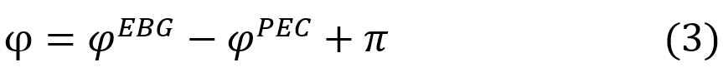
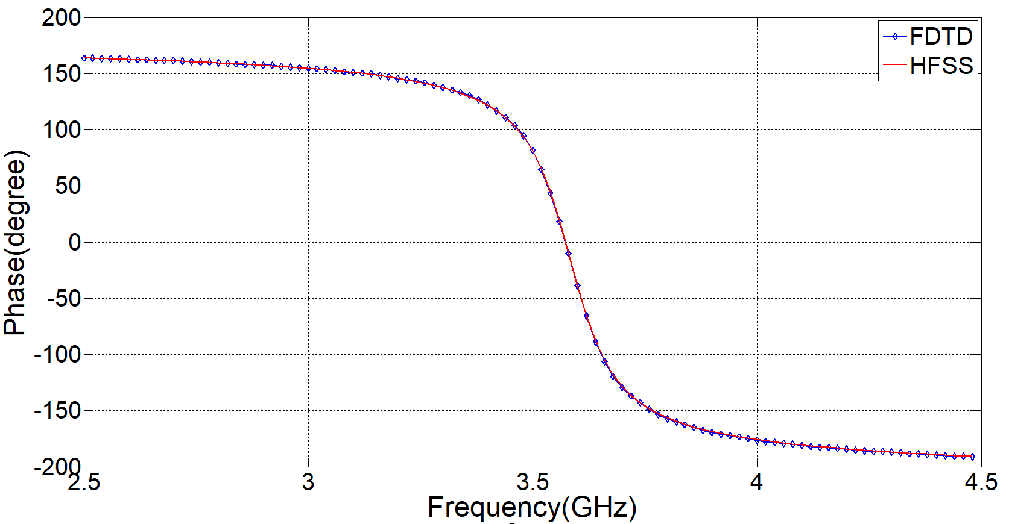
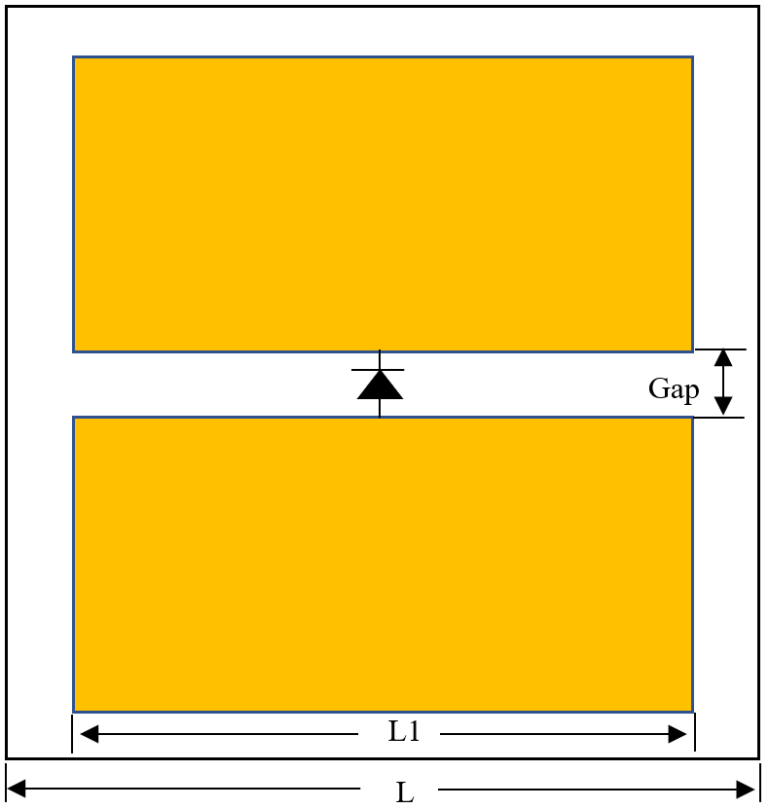
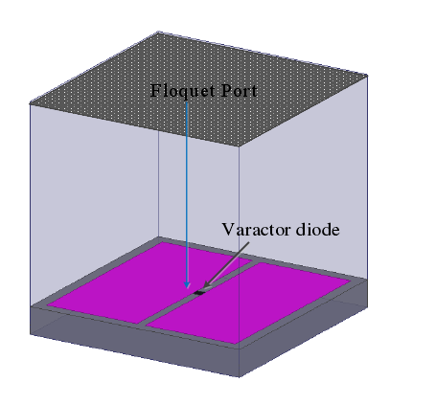
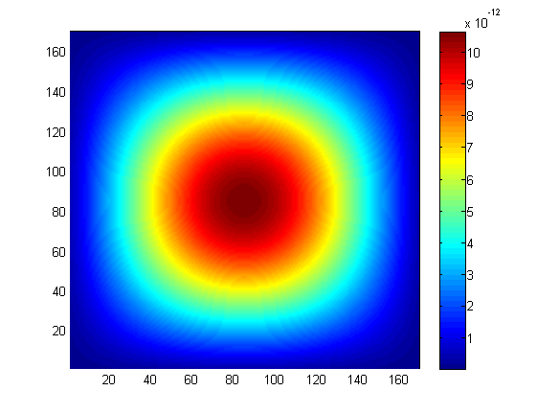
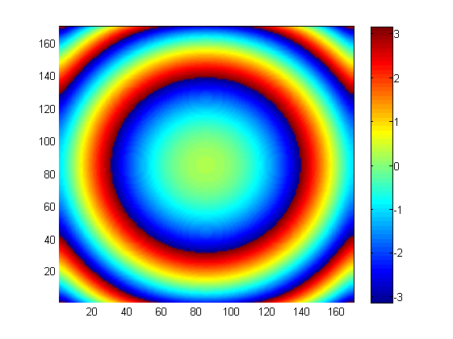
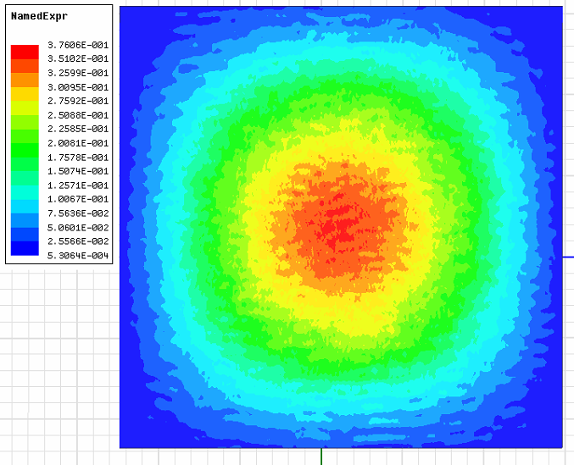
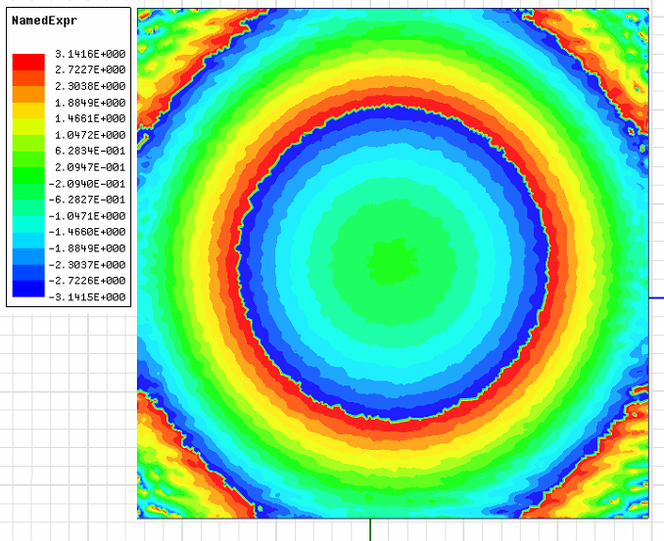
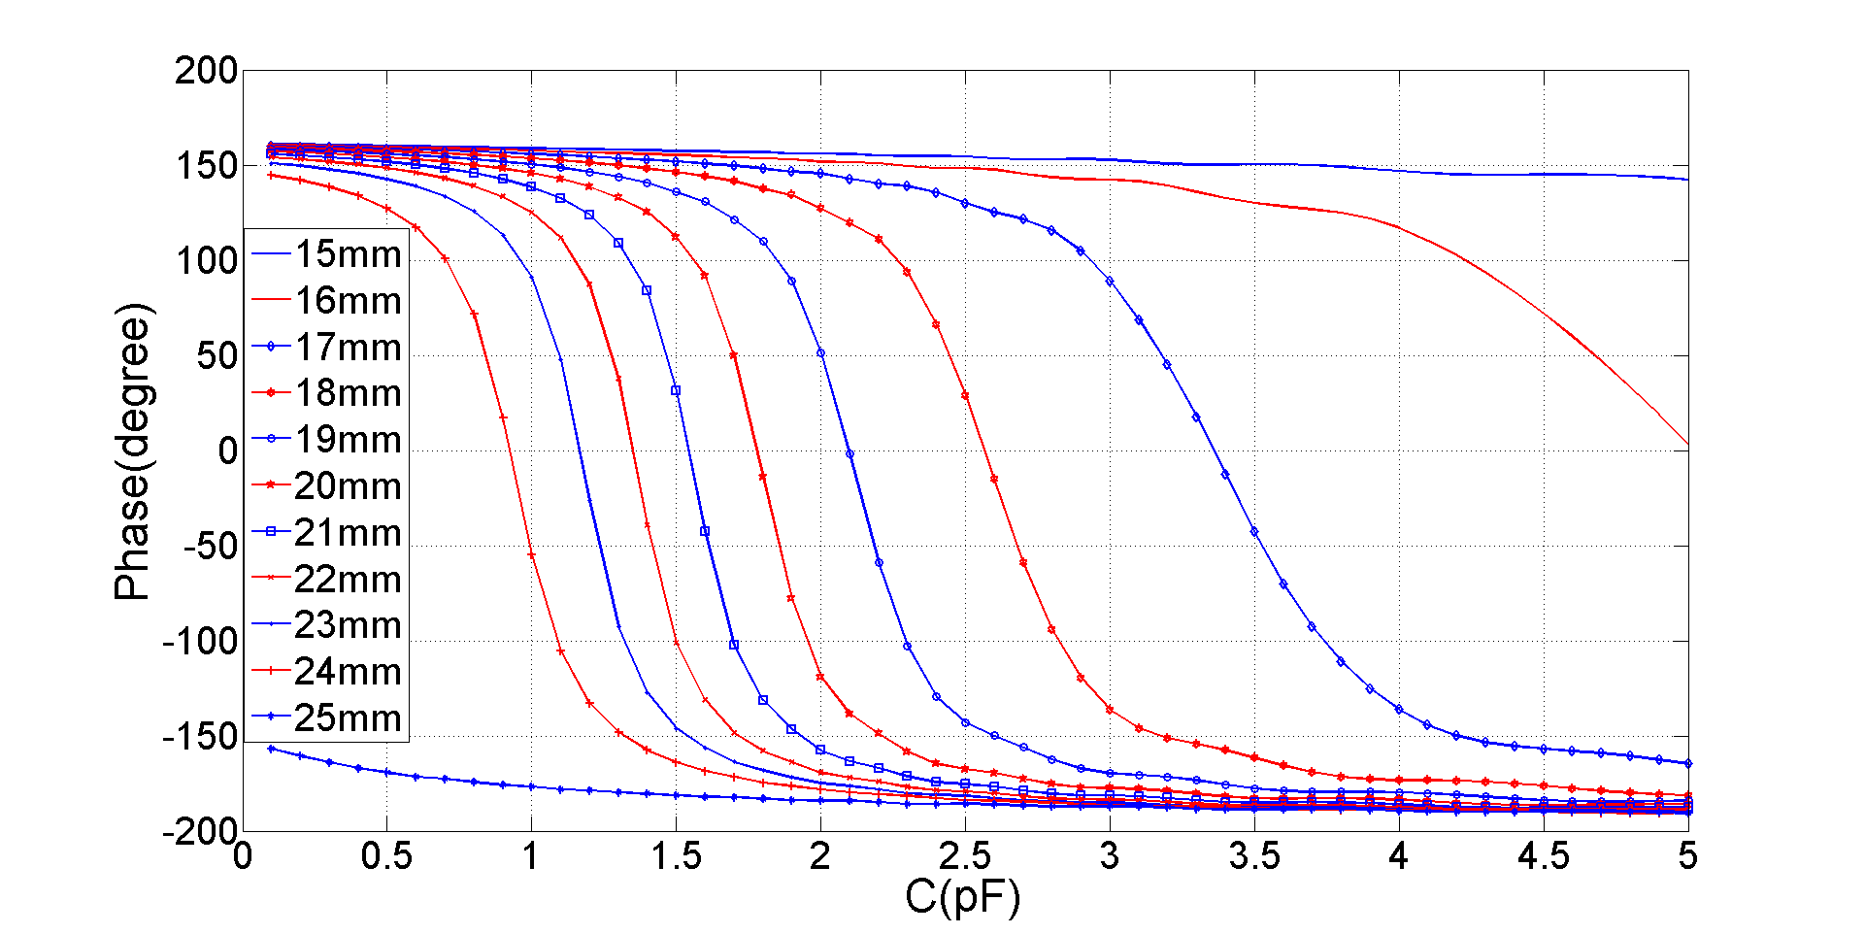
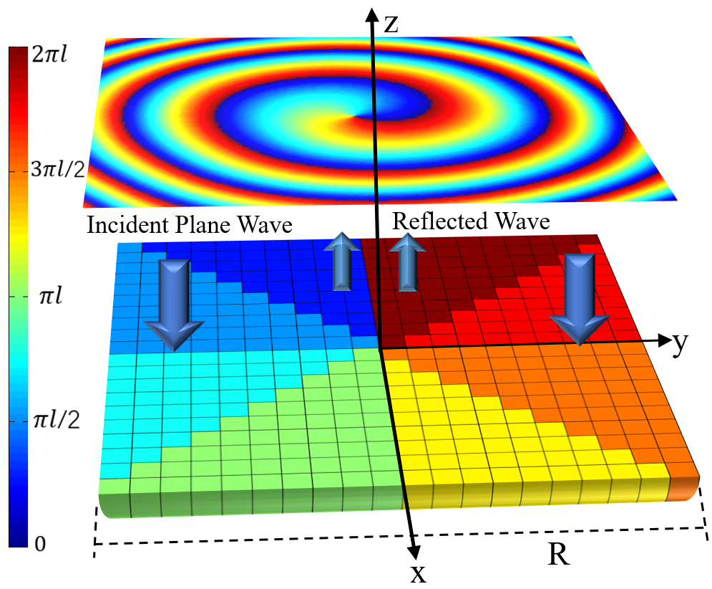
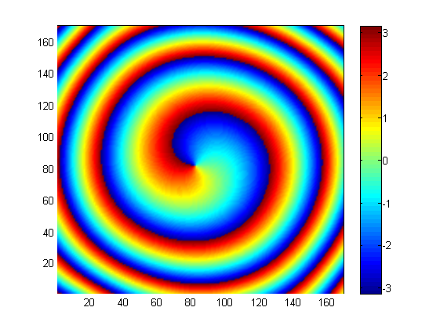
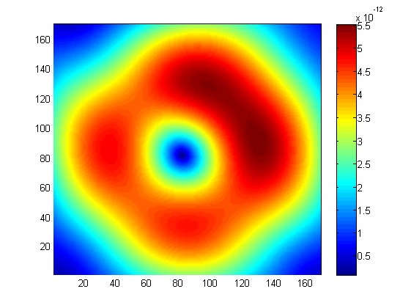
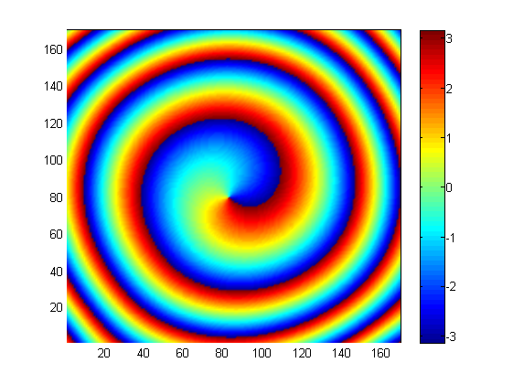
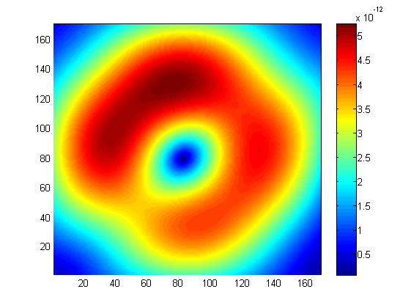
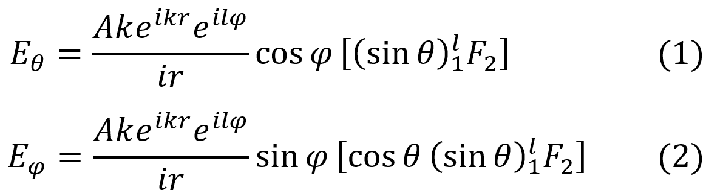
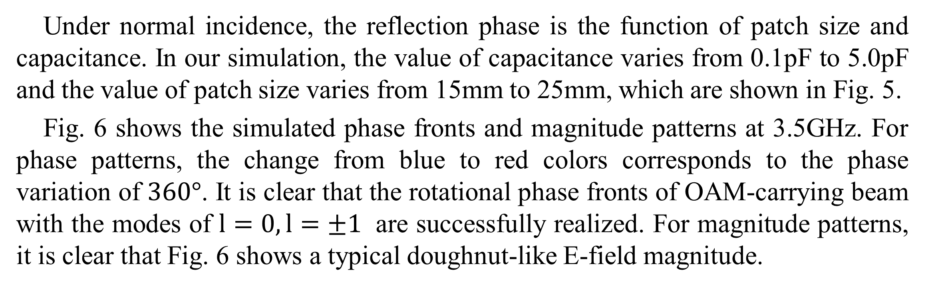
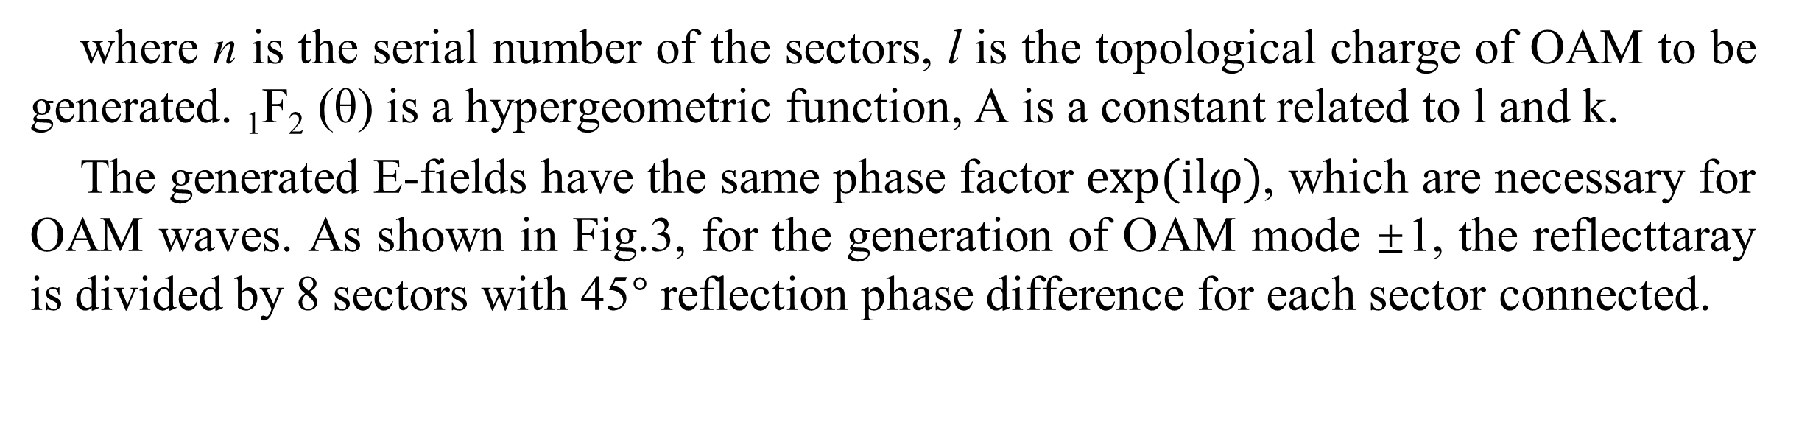
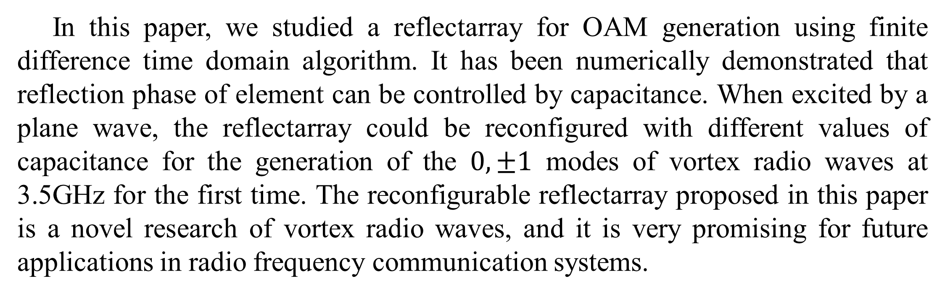
FDTD Modeling of Reconfigurable Reflectarray for Generation of Vortex Radio Waves
Chen-Chen Li¹, Hao Xie¹, and Lin-Sheng Wu²
²Key Laboratory of Ministry of Education of Design and Electromagnetic Compatibility of High-Speed Electronic Systems, Shanghai Jiao Tong University, Shanghai 200240, China.
Abstract- A reconfigurable reflectarray is proposed for the first time to generate vortex radio waves in radio frequency domain. In this paper, OAM generating reflectarray is simulated by our in-house-developed finite difference time domain algorithm, which is validated by comparing the simulated vortex radio waves with its counterpart obtained by commercial software. Simulations show that the 0, ±1 mode of vortex radio waves can be generated at 3.5GHz. The proposed method and reflectarray is a valuable way to generate vortex radio waves for microwave wireless communication systems.
Introduction
Recent studies show that besides the optical regime, orbital angular momentum(OAM) can also be applied in the radio frequency domain. Although OAM is a subset of MIMO, with an OAM based system, it is vital to find functional antennas for the generation of vortex waves. In 2014, a planar-spiral phase plate (planar-SPP) was experimentally demonstrated to generate arbitrary mixed OAM beams. In 2016, L. Long et al. demonstrated experimentally a reflective metasurface for the generation of different modes of vortex radio waves. In the same year, a reconfigurable graphene reflectarray antenna was proposed for generation of vortex THz waves, but in radio frequency domain, antennas for generation of vortex waves remains unreconfigurable.
Unit Structure
Fig. 3. Reflection phase as functions of frequency with patch size L=20mm and capacitance C=1.63μF.
In our simulation, we use equivalent surface currents and the vector potential approach to compute the unknown far fields from the known electric and magnetic currents. Using our FDTD algorithm, we can get E-field distribution at the plane perpendicular to the z ̂ axis and it is located at z=8.0m.
(a) (b)
Fig. 1. (a) Unit structure of reflecttaray (b) Unit model simulated in HFSS
Two metal patches and a gap between them, where in the middle a variable capacitance diode is placed, are selected as the unit cell of the reflectarray proposed in this paper. Each element consists of a substrate (ε_{r}=2.65) of the thick of 2mm with two metal patches printed on the top surface and the length of metal patches is 20mm(L1). Behind the substrate is metal ground that is for reflection. With the control of the voltage between two mental patches, capacitance of variable capacitance diode in each unit can be changed, so that the unit cell has a continuous reflection phase which has a rang more than 300°. As shown in Fig.1(b), we analyze the reflection phase characteristic of elements using an infinite periodic model with ANSYS HFSS, which is based on a finite-element algorithm.
(a) (b) (c) (d)
Fig. 4. Simulated electrical field distribution in the far-field zone of z=8.0m, whose OAM mode number is 0. (a) magnitude distribution using FDTD algorithm, (b) phase distribution using FDTD algorithm, (c) magnitude distribution simulated by HFSS, (d) phase distribution simulated by HFSS.
Numerical Results
Reflectarray Antenna
Fig. 5. Reflection phases as functions of patch size and capacitance
Fig. 2. Reflective surface model that consists of N sectors with varying phase from 0 to 2πl and is excited by plane wave.
(a) (b)
Fig. 6. Simulated phase fronts and magnitude patterns of the vortex radio waves with the modes: (a) l=1; (b) l=$−1$;
A sectored circular reflective surface model consisting of N sectors is used to generate vortex radio waves, which is shown in Fig. 2. It is excited by a normally incident plane wave and the far-field expression of reflective field can be expressed as:
Under normal incidence, the reflection phase is the function of patch size and capacitance. In our simulation, the value of capacitance varies from 0.1pF to 5.0pF and the value of patch size varies from 15mm to 25mm, which are shown in Fig. 5.
Fig. 6 shows the simulated phase fronts and magnitude patterns at 3.5GHz. For phase patterns, the change from blue to red colors corresponds to the phase variation of $360°$. It is clear that the rotational phase fronts of OAM-carrying beam with the modes of $l=0, l=±1$ are successfully realized. For magnitude patterns, it is clear that Fig. 6 shows a typical doughnut-like E-field magnitude.
where n is the serial number of the sectors, l is the topological charge of OAM to be generated. ₁F₂ (θ) is a hypergeometric function, A is a constant related to l and k.
The generated E-fields have the same phase factor $exp⁡(ilφ)$, which are necessary for OAM waves. As shown in Fig.3, for the generation of OAM mode ±1, the reflecttaray is divided by 8 sectors with 45° reflection phase difference for each sector connected.
Conclusion
In this paper, we studied a reflectarray for OAM generation using finite difference time domain algorithm. It has been numerically demonstrated that reflection phase of element can be controlled by capacitance. When excited by a plane wave, the reflectarray could be reconfigured with different values of capacitance for the generation of the $0, ±1$ modes of vortex radio waves at 3.5GHz for the first time. The reconfigurable reflectarray proposed in this paper is a novel research of vortex radio waves, and it is very promising for future applications in radio frequency communication systems.
Algorithm and Validation
A single unit of the reflecttaray is simulated with periodic boundary conditions (PBC) on four sides to model an infinite periodic structure. The reflection phase is calculated as:
2017 IEEE Electrical Design of Advanced Packaging & Systems Symposium (2017 IEEE EDAPS), December 14 to 16, 2017, Haining, China
Fig. 2. Normalized Hz-field distribution around the composite wedge excited by a line source, where conformal FDTD result is compared with that of MOM/PO method.

